Slide 1
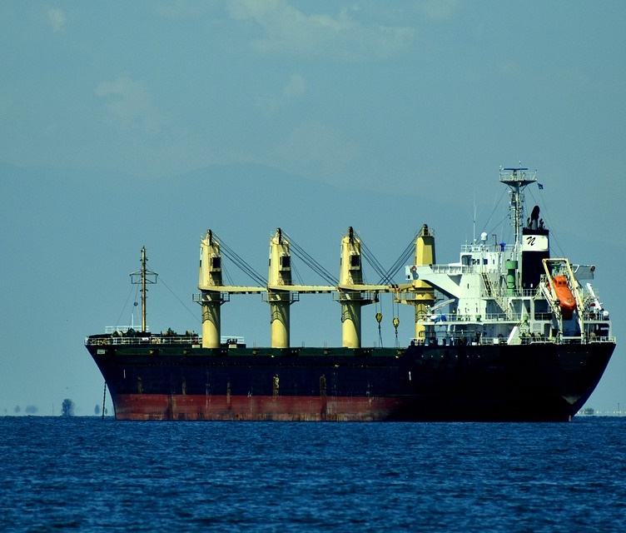

MAINTENANCE AND CURE
Ancient remedy—
modern applications
NotariLaw.com

Slide 2
Maintenance and cure
concerns the employer’s “obligation to provide food, lodging, and medical services to a seaman injured while serving the ship.” Atl. Sounding Co., Inc. v. Townsend, 557 U.S. 404, 407-08 (2009).
Ancient/expansive/presumption.

Slide 3
Maintenance and cure
Broad, liberal interpretation.
Non-delegable duty.
Encompasses the obligation to:
  provide living expenses;
  promptly provide medical care on board;
  promptly approve reasonable medical treatment.

Slide 4
Punitive Damages
Punitive damages (plus reasonable attorneys’ fees) available for willful and wanton disregard of seafarer’s medical needs.
  The failure to provide proper medical care for seafarers has provided the impetus for punitive damage awards. See The City of Carlisle, 39 F. 807 (DC Ore. 1889).

Slide 5
Vicarious Liability
The employer is liable for the negligence of a physician that it hires to treat its crew. Olsen v. Am. S.S. Co., 176 F.3d 891, 895-896 (6th Cir. 1999).
  Doctor as agent.
  Selected/engaged by the employer.

Slide 6
Adams v. Liberty Maritime Corp. et al., No. 2:16-CV-05352 (GRB),
2020 WL 4380996
(E.D.N.Y. July 31, 2020).
NotariLaw.com

Slide 7
Adams v. Liberty Maritime Corp.
2020 WL 4380996
Crewmember (CM) known to have high blood pressure and diabetes.
Reported breathing issues and painful swelling in his legs and feet.
Captain e-mailed Future Care (Telemedicine provider).
Future Care relayed this information to a doctor in its shipboard medical call line.

Slide 8
Doctor’s actions
The Doctor diagnosed the crewmember’s condition as venous stasis—a chronic vein disease not specifically treatable with medication.
The Doctor also advised the captain to confirm whether the CM was experiencing wheezing or difficulty breathing.

Slide 9
Captain’s actions
Withheld information from Future Care regarding the swelling in the CM’s legs
Inaccurately reported the breathing problems.
  No entries in the ship’s medical log.
  Suspicious that the CM was faking symptoms.
  Reluctant to have CM seek shoreside medical care to save the company money.

Slide 10
Adams v. Liberty Maritime Corp.
2020 WL 4380996
Despite numerous requests, the CM was denied shoreside medical care for 2 weeks.
Threatened to swim to shore.
Future Care got a second opinion.
Turned out to be congestive heart failure, atrial fibrillation, and pneumonia.

Slide 11
Finally disembarked and hospitalized
Suffered 2 heart attacks.
Surgery to address blockages in his coronary arteries.

Slide 12
The Lawsuit
CM sued:
  Employer (Liberty Maritime)
  Captain of the ship
  Telemedicine provider (Future Care)
    Summary judgment on the grounds that it engaged independent contractor-physicians to dispense medical advice.

Slide 13
Discussion
NotariLaw.com

Slide 14
Unseaworthiness
could cover insufficient or negligent provision of medical care.
The Court observed, without deciding, that where liability is imposed for failure to provide adequate training, the training typically relates to the operation of the vessel. (E.g., maneuvering, line handling).
Different standard for cruise ships that carry doctors?

Slide 15
Jones Act Negligence
Violation of the duty to provide proper medical treatment is actionable under the Jones Act.
Improperly providing for a seafarer’s care, including the negligent selection of a doctor;
the malpractice of the doctor.
  Fact-specific inquiry.

Slide 16
Jones Act Negligence (1)
Employer’s vicarious liability for the doctor’s malpractice.
Not merely the wrong diagnosis, but a negligent diagnosis.
CM should have been tested more extensively for CHF.
∴ Liberty Maritime was negligent in its duty to provide adequate medical treatment.

Slide 17
Jones Act Negligence (2)
Employer vicariously liable for captain’s negligence.
Guardian-ward relationship between the master and the seafarers.
The captain (and the company) were negligent in the duty to provide appropriate medical care for the sick CM.

Slide 18
Statute of Limitations
46 U.S.C. § 30510: Vicarious liability for medical malpractice with regard to crew
Applying a three-year limitations period for vicarious liability for negligent telemedicine services, as opposed to malpractice at a “shoreside facility.”

Slide 19
Compensatory Damages
Unpaid Maintenance and Cure
Lost wages
Pain and Suffering = 3 times the recoverable lost wages.
Joint & Several Liability (captain and employer)
  Except Maintenance and Cure is against employer only.

Slide 20
Punitive Damages
Punitives (failure to provide medical care; attempted cover-up)
  ⅓ of the pain and suffering + lost wages + maintenance & cure.
imposed against the captain.
Captain had a surprising amount of discretion.
Lack of oversight relating to crew medical care.
∴ Liability for the punitive damages award also imputed to employer (for enabling).

Slide 21
Punitive Damages
No punitive damages for delayed maintenance payments and reimbursement of medical expenses because no evidence it was willful or wanton.

Slide 22
Arguable ADA claim?
If CM could prove that he was discriminated against and denied medical care because he was a diabetic …
  Diabetes is recognized as a disability that substantially limits the function of the endocrine system.
CM was qualified to perform essential functions of the job with or without reasonable accommodation.
Schultz v. Royal Caribbean Cruises, Ltd., No. 18-cv-24023, 2020 WL 3035233 (S.D. Fla. June 5, 2020) (applying ADA to U.S. citizen’s dispute against RCCL).

Slide 23
Prejudgment interest
Hybrid Jones Act-Unseaworthiness
Within the court’s discretion
Despite the finding of no unseaworthiness
Applied the state statutory prejudgment interest rate.
NotariLaw.com

